Slide 1
DIYALA UNIVERSITY COLLEGE OF ENGINEERING DEPARTMENT OF COMMUNICATIONS ENGINEERING
Mathematics- II
$$6^{th }Lecture$$
First Year
lecturer
Wisam Hayder
2021

Slide 2
Vectors and the Geometry of Space
The Cross Product
The Cross Product of Two Vectors in Space
We start with two nonzero vectors u and v in space. If u and v are not parallel, they determine a plane.
We select a unit vector n perpendicular to the plane by the right-hand rule.
This means that we choose n to be the unit (normal) vector that points the way your right thumb points when your fingers curl through the angle from u to v (Figure 12.27).
Then the cross product u * v (“u cross v”) is the vector defined as follows.

Slide 3
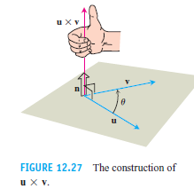
Vectors and the Geometry of Space

Slide 4
Vectors and the Geometry of Space
Notes:
aaa

Slide 5
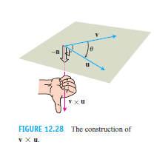
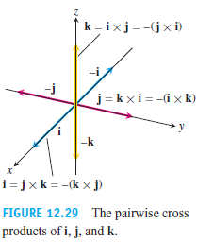
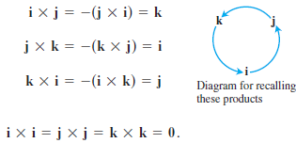
Vectors and the Geometry of Space

Slide 6
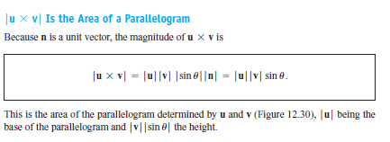
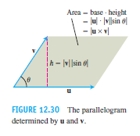
Vectors and the Geometry of Space
Notes:
aaa

Slide 7
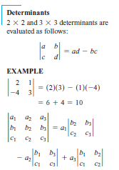
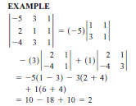
Vectors and the Geometry of Space
Notes:
aaa

Slide 8
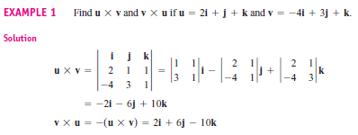
Vectors and the Geometry of Space

Slide 9
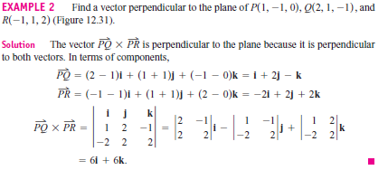
Vectors and the Geometry of Space

Slide 10
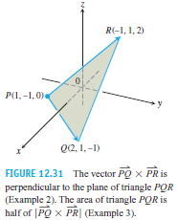
Vectors and the Geometry of Space
Notes:
aaa

Slide 11
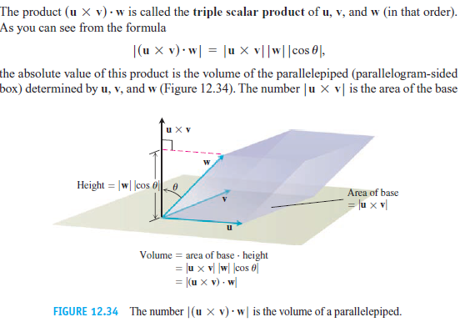
Vectors and the Geometry of Space
Triple Scalar or Box Product
Notes:
aaa

Slide 12
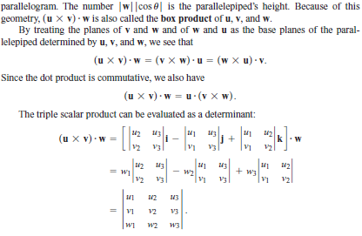
Vectors and the Geometry of Space
Notes:
aaa

Slide 13
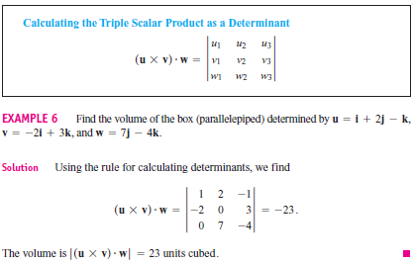
Vectors and the Geometry of Space
Notes:
aaa

Slide 14
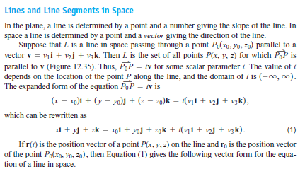
Vectors and the Geometry of Space

Slide 15
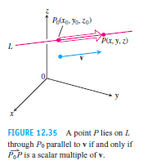
Vectors and the Geometry of Space

Slide 16
Vectors and the Geometry of Space

Slide 17
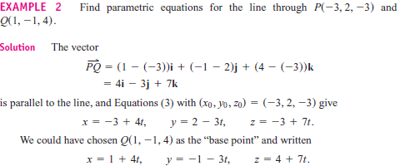
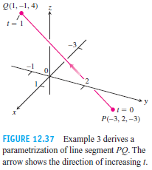
Vectors and the Geometry of Space

Slide 18
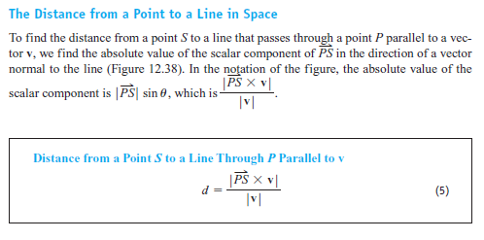
Vectors and the Geometry of Space
The Distance from a Point to a Line in Space

Slide 19
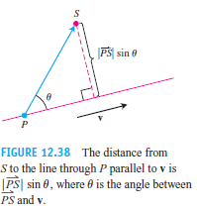
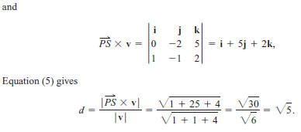
Vectors and the Geometry of Space

Slide 20
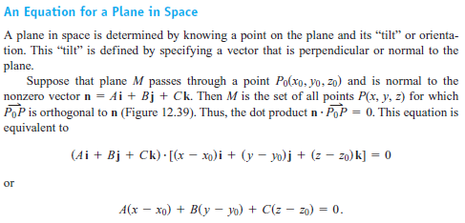
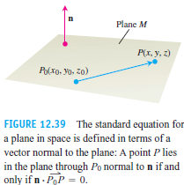
Vectors and the Geometry of Space

Slide 21
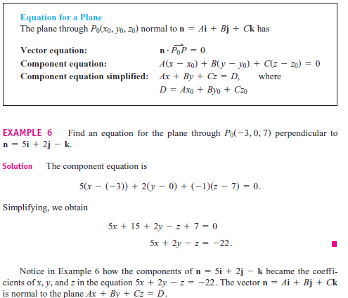
Vectors and the Geometry of Space

Slide 22
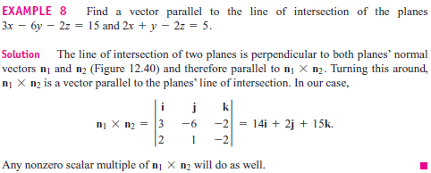
Vectors and the Geometry of Space
Lines of Intersection
Just as lines are parallel if and only if they have the same direction, two planes are parallel if and only if their normals are parallel, or for some scalar k. Two planes that are not parallel intersect in a line.

Slide 23
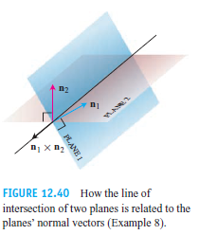
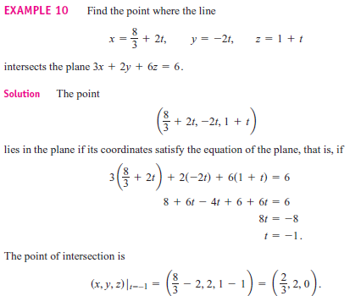
Vectors and the Geometry of Space

Slide 24
Vectors and the Geometry of Space

Slide 25
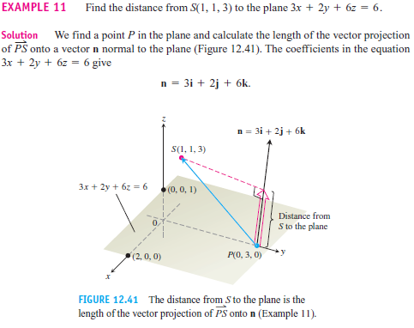
Vectors and the Geometry of Space

Slide 26
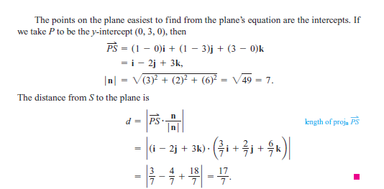
Vectors and the Geometry of Space

Slide 27
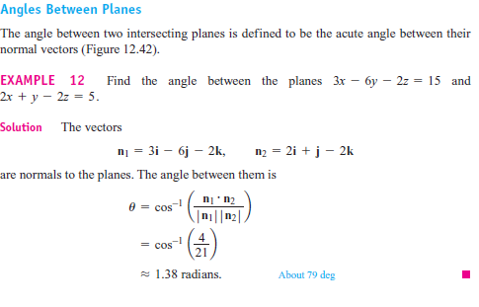
Vectors and the Geometry of Space

Slide 28
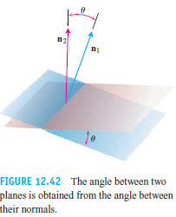
Vectors and the Geometry of Space

Slide 29
Vectors and the Geometry of Space
Cylinders and Quadric Surfaces
Cylinders
A cylinder is a surface that is generated by moving a straight line along a given planar curve while holding the line parallel to a given fixed line. The curve is called a generating curve for the cylinder (Figure 12.43). In solid geometry, where cylinder means circular cylinder, the generating curves are circles, but now we allow generating curves of any kind. The cylinder in our first example is generated by a parabola.

Slide 30
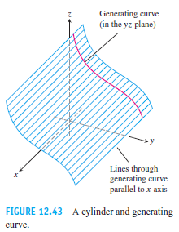
Vectors and the Geometry of Space

Slide 31
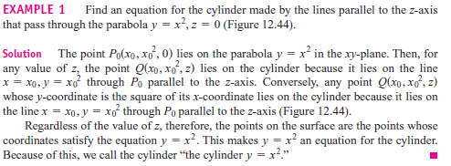
Vectors and the Geometry of Space

Slide 32
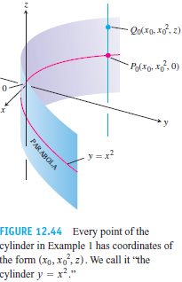
Vectors and the Geometry of Space

Slide 33
Vectors and the Geometry of Space
Quadric Surfaces
A quadric surface is the graph in space of a second-degree equation in x, y, and z. We focus on the special equation
${Ax}^{2}+{By}^{2}+{Cz}^{2}+Dz=E$
where A, B, C, D, and E are constants. The basic quadric surfaces are ellipsoids, paraboloids, elliptical cones, and hyperboloids. Spheres are special cases of ellipsoids. We present a few examples illustrating how to sketch a quadric surface, and then give a summary table of graphs of the basic types.

Slide 34
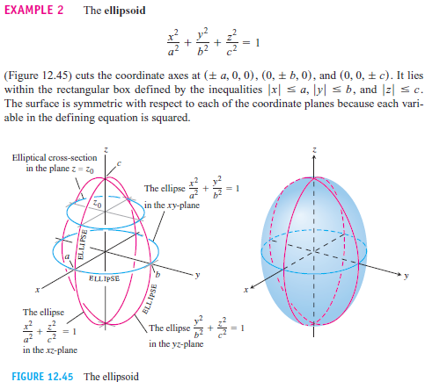
Vectors and the Geometry of Space

Slide 35
Vectors and the Geometry of Space

Slide 36
Vectors and the Geometry of Space
Ex 1. Find the length and direction (when defined) of u x v and v x u for following:
1. u = 2i - 2j - k, v = i – k
Sol.
u= = 2i + 3j, v = -i + j
Sol.

Slide 37
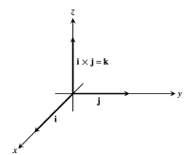
Vectors and the Geometry of Space
3. u = 2i - 2j + 4k, v = -i + j - 2k
Sol.
Ex2. sketch the coordinate axes and then include the vectors u, v, and as vectors starting at the origin.
u = i, v = j
Sol.

Slide 38
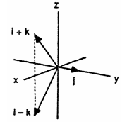
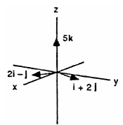
Vectors and the Geometry of Space
u = i - k, v = j
Sol.
u = 2i - j, v = i + 2j
Sol.

Slide 39
Vectors and the Geometry of Space
Ex 3. a. Find the area of the triangle determined by the points P, Q, and R. b. Find a unit vector perpendicular to plane PQR.
P(1, -1, 2), Q(2, 0, -1), R(0, 2, 1).
Sol.

Slide 40
Vectors and the Geometry of Space
Ex 4. Verify that (u x v) .w = (v x w). u = (w x u).v and find the volume of the parallelepiped (box) determined by u, v, and w.
u= 2i, v = 2j, w=2k
Sol.

Slide 41
Vectors and the Geometry of Space
Ex 5. Find parametric equations for the lines
The line through the point P(3, -4, -1) parallel to the vector i+j+k
Sol.
2. The line through P(1, 2, -1) and Q( -1, 0, 1).
Sol.

Slide 42
Vectors and the Geometry of Space
Ex 6. Find equations for the planes
The plane through (1,1-,3) parallel to the plane 3x + y + z = 7
Sol.
2. The plane through $p_{0}$(0,2,-1) normal to n = 3i - 2j – k.
Sol.

Slide 43
Vectors and the Geometry of Space
Ex 7. Find the point of intersection of the lines x = 2t + 1, y = 3t + 2,
z = 4t + 3 and x = s + 2, y = 2s + 4, z = -4s – 1.
Sol.

Slide 44
Vectors and the Geometry of Space
Ex 8. Find a plane through the points P1(1, 2, 3), P2(3, 2, 1) and perpendicular to the plane 4x - y + 2z = 7.
Sol.
is the desired plane.

Slide 45
Vectors and the Geometry of Space
Ex 9. Find the distance from the point to the line
(0, 0, 12); x = 4t, y = -2t, z = 2t
Sol.

Slide 46
Vectors and the Geometry of Space
2. (0, 0, 0) ; x = 5 + 3t, y = 5 + 4t, z = -3 - 5t.
Sol.
is the distance from S to the line

Slide 47
Vectors and the Geometry of Space
Ex 10. Find the angles between the planes x + y = 1, 2x + y - 2z = 2
Sol.

